Slide 1
Challenges of Optical Character Recognition
Orville Anderson
University of Minnesota Morris, Senior Seminar, Fall 2025

Slide 2

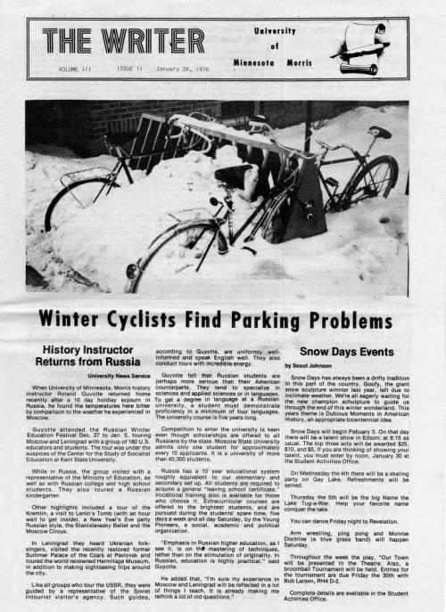
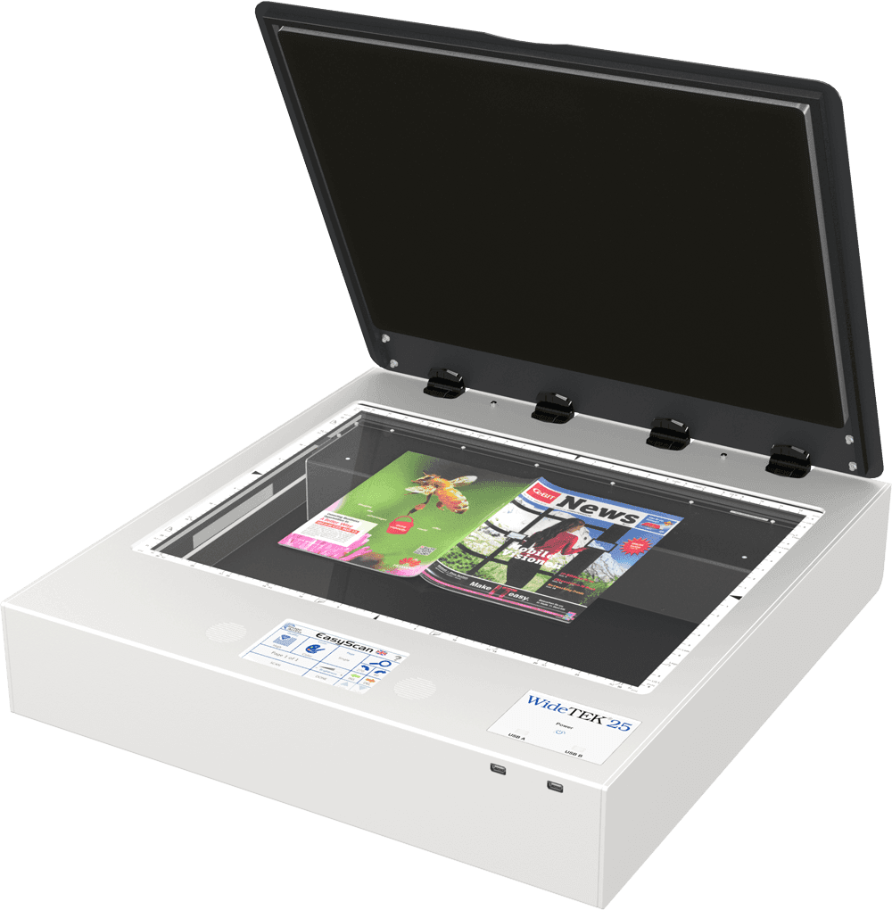
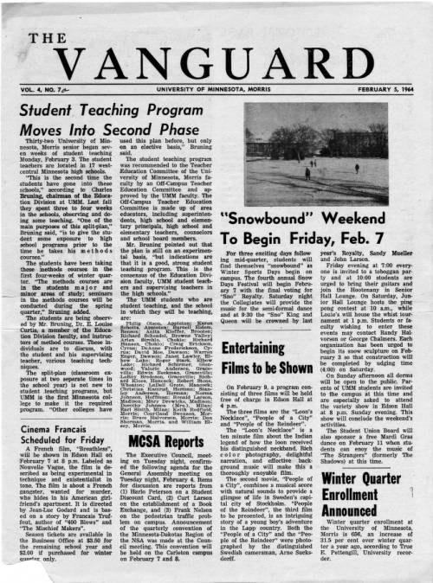

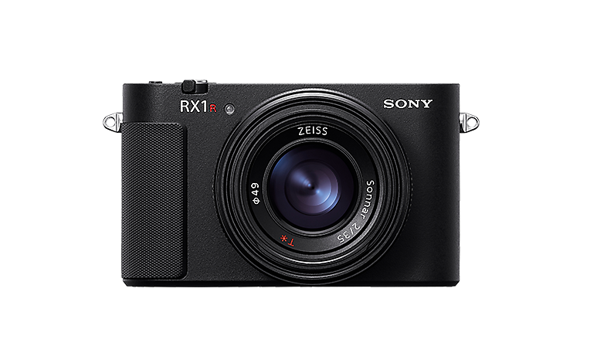

How to make a Scanned Document
Process
Limitations

Slide 3
What Is OCR?
Defined as: the process of extracting text from images
OCR model/software/technology means something performing this process
Useful to digitize scanned documents (for research, digital accessibility, etc.)
Reduced accuracy on certain documents

Slide 4
Presentation Outline
Background
What is OCR?
Methods
Case Study
Introduction
Traits
Conclusion
Case Study Importance
Larger Picture
Stages of OCR
Results
Notes:
The case study is an experiment, which involved making a big collection of images, so I am going to introduce it, talk about some of the traits of the collection, they talk about the results of the experiment portion.
This presentation is split into three sections: background, a case study, and a bit of discussion
The background includes some definitions and information on methods
The case study is the bulk of this presentation. In short, some guy put together a whole bunch of documents to see what OCR model worked best for him
The conclusion goes over the importance of this specific case study, then talks about the larger impact

Slide 5

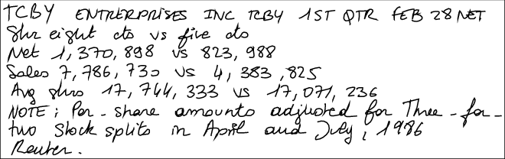

OCR Stages
Image
(Scanned Doc)
Document Layout Analysis
Text Line Detection
Classification / Recogniton
Editable Text
Input
Output
Animal
A
Notes:
TLD uses pre-determined box sizes to isolate characters. There is generally some adjustments of the character, like rotating or centering it, to make the characters more uniform.
Classification of the un-identified character is where most of this process is, and I will talk about it on the next slide
The final part of this process is to repeat the classification step on every character found on the document, then to recombine the sections of text into one text file.
Skipping: DLA includes some idea of text order

Slide 6
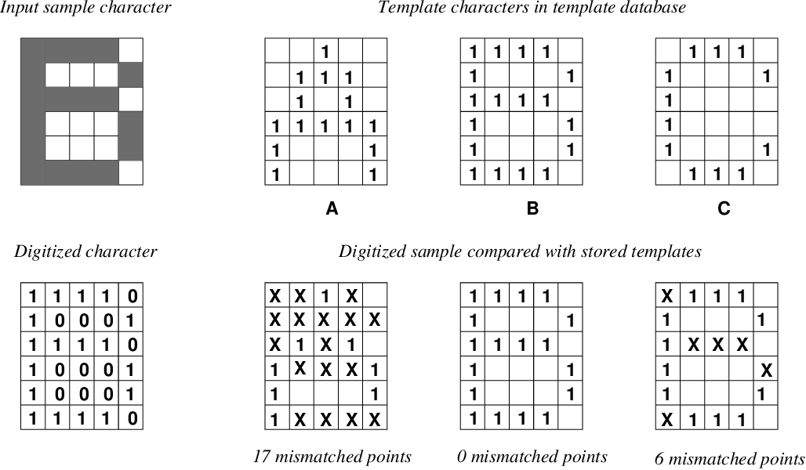
Classification Method – Matrix Matching
From TLD Stage
Foundational classification method
Patented in early 1930s
In use into the 1990s
Notes:
Neural Networks have the advantage of a bit more flexibility in what it considers it’s collection of “known characters”.
Define Training
Img from: https://www.semanticscholar.org/paper/An-Implementation-of-OCR-System-Based-on-Skeleton-Li/1dd99c2718a4e66b9d727a91bbf23cd777cf631c, https://kar.kent.ac.uk/21129/1/OCRNing.pdf
Facts from: https://archive.org/details/historyofocropti0000scha

Slide 7
Classification Method – Matrix Matching
From TLD Stage
Output
0
0
1
0
0
0
1
1
1
0
0
1
0
1
0
1
1
1
1
1
1
0
0
0
1
1
0
0
0
1
1
1
1
1
0
1
1
1
1
0
Foundational classification method
Patented in early 1930s
In use into the 1990s
1
0
0
0
1
1
0
0
0
1
1
1
1
1
0
1
1
1
1
0
1
0
0
0
1
1
0
0
0
1
1
0
0
0
1
1
1
1
1
0
1
0
0
0
1
1
1
1
1
0
0
1
1
1
0
1
0
0
0
1
1
0
0
0
0
1
0
0
0
0
Input
1
0
0
0
1
0
1
1
1
0
Dictionary
Notes:
Neural Networks have the advantage of a bit more flexibility in what it considers it’s collection of “known characters”.
Define Training
Img from: https://www.semanticscholar.org/paper/An-Implementation-of-OCR-System-Based-on-Skeleton-Li/1dd99c2718a4e66b9d727a91bbf23cd777cf631c, https://kar.kent.ac.uk/21129/1/OCRNing.pdf
Facts from: https://archive.org/details/historyofocropti0000scha

Slide 8
Classification Method – Neural Network
Input
Dictionary
Output is confidence as a %
0*0+
0*0
0*0+
1*0 = 0
0
0
0
1
0*1+
0*0
0*0+
1*0 = 0
A: 99%
B: 80%
…
Z: 12%
0
0
0
1
Notes:
Neural Networks have the advantage of a bit more flexibility in what it considers it’s collection of “known characters”.
Define Training

Slide 9
Classification Method – Neural Network
A more complex version of matrix matching
Looks for patterns in the pixels
Presence of patterns has larger influence on output (confidence %)
Allows us to identify full lines at once
Easier to update collection of known characters
Input:
Lots of Math
Output:
Each possible outcome (character) and a confidence %
Notes:
Neural Networks have the advantage of a bit more flexibility in what it considers it’s collection of “known characters”.
Define Training

Slide 10
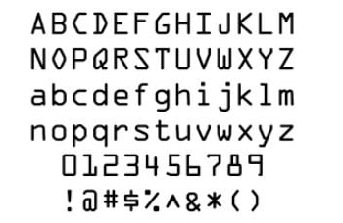
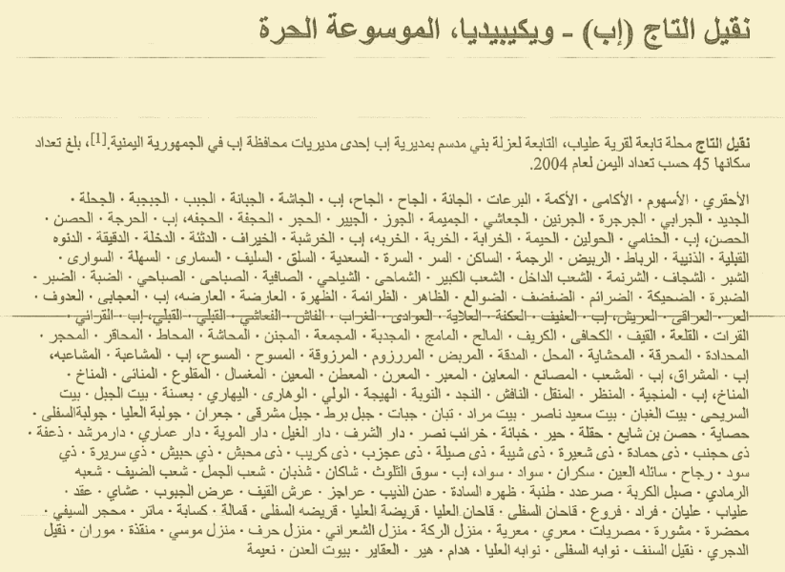
Summary
Limited to “known characters” and fonts
Need examples of more characters and fonts
Case study is a document collection to evaluate accuracy, but can be used to train

Slide 11
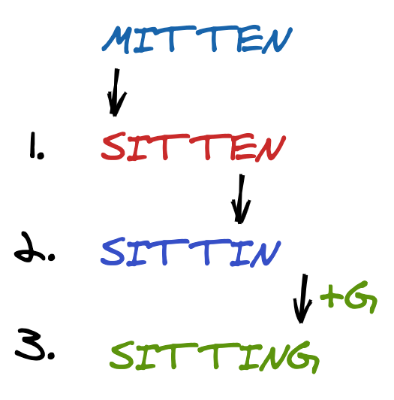
Comparison
How to Compare
Method
Many ways to compare OCR models
For accuracy:
Need OCR output
Need ground truth
Judge accuracy by individual characters
OCR Output
Ground Truth
Notes:
There are many ways to compare OCR implementations, such as if you need to pay to use them and what languages they can be used on.
The case study we are about to talk about is primarily comparing three implementation based on character accuracy. He measures accuracy as the number of insertions, deletions and substitutions needed to make the OCR output match the ground truth. The number of modifications is then divided by the number of characters from the document, to make it a percentage.

Slide 12
Case Study
Source Documents
Old Books
Apply Noise
Apply OCR
Used 3 popular models from the time
Arabic Wikipedia
Thomas Hegghammer, 2021
Historian who works with historic Arabic texts
Wanted to digitize documents
Collection is called Noisy OCR Dataset (NOD)
Focus on noise, layout, and langauge

Slide 13
Layout
Examples are from English Old Books
Arabic Wikipedia articles had limited layout variation
Does not include two column layouts and tables

Slide 14
Preserving Layout
Image
(Scanned Doc)
Document Layout Analysis
Text Line Detection
Classification / Recogniton
Editable Text
Record order of text
Put individual characters back in order
1
2
1
2
3
1
3
5
3
4
2
4
4
6
5
5
6
6
Notes:
Remember the stages of OCR? Remember how in DLA we needed to mark the order of text regions? Remember how when we combined the individual characters to make the editable text they needed to be put back in order?
Some awareness is needed to use OCR on documents that are not just one single text column.

Slide 15
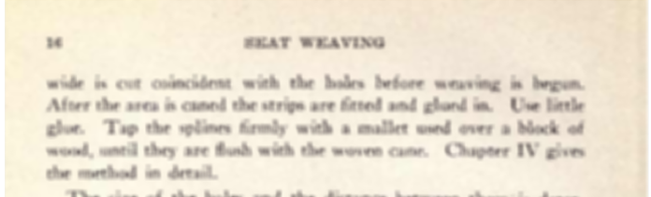
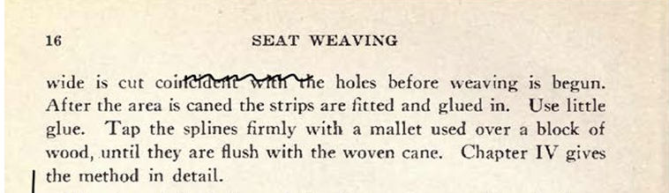
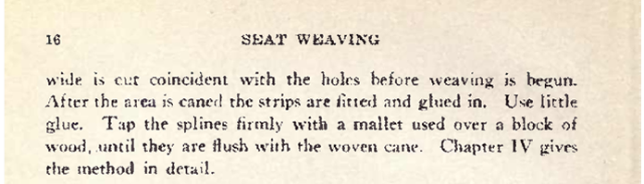
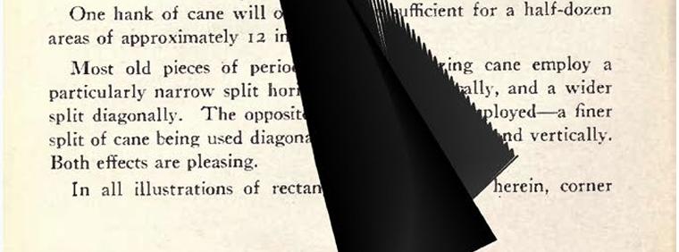
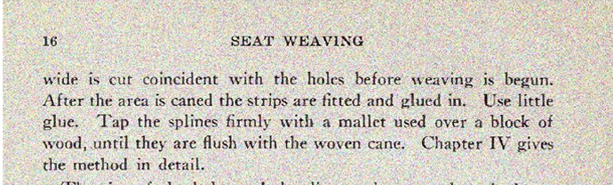
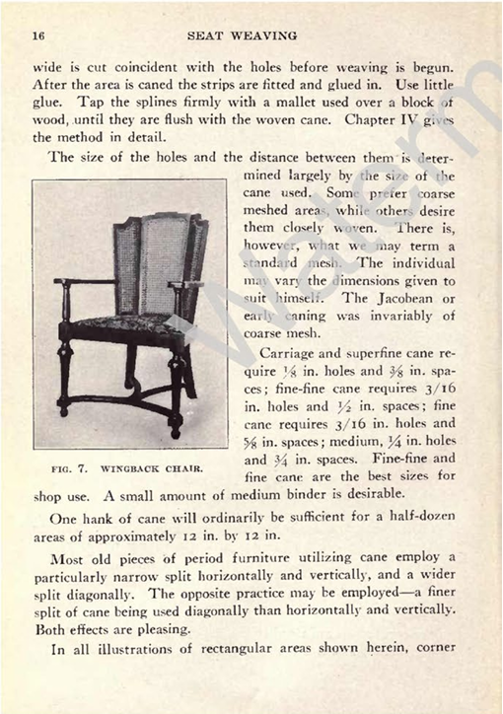
Noise Types
Blur
Scribbles
Picked because they are the most common noise found in historical documents
Splits into two categories:
Mistaken for text
Obscures text
Weak Ink
Ink Stain
Salt and Pepper
Watermark

Slide 16

Noise
Mistaken for text
Obscured Text
Remove noise (pre-processing)
Spellcheck (post-processing)
OCR needs to know what to do with the unreadable space (related to layout struggles)

Slide 17

Writing Systems
Most OCR are made for Latin based written languages: English, Spanish, German, etc.
Latin is the most widely used writing system
OCR tech is limited to characters it has been exposed to previously
Arabic, the third most widely used writing system is very different from Latin
Diacritics
Cursive or connected characters

Slide 18
Why is Writing System a Challenge
Need to adjust Text Line Detection box sizes
Noise prevention techniques can remove diacritics
Areas with low confidence
Example from model which identifies full lines of text (instead of words)
Notes:
Remember my comment about the TLD stage using predetermined box sizes? Some studies found that cursive characters need larger boxes
Remember noise prevention techniques? What do you think those do to diacritics?
Example text is about a swiss architect wining a challenge to design a French park

Slide 19
Results – Models, Writing Systems, and Layout
Some OCR models cost money
Some were easier to use
Some had limited support for languages
Did not talk much about layouts, still important though
Model | Paid? | User Interface? | Arabic?
Google Document AI | Yes | Yes | Yes
Amazon Textract | Yes | Yes | No
Tesseract | No | No | Yes
Notes:
As mentioned earlier Hegghammer is an academic working with a large amount of documents. He spends a bit of time talking about price,
Need to actually talk about accuracy differences in writing systems, maybe also mention his lack of discussion on layout’s impact.
Fun fact, like all of these have changed

Slide 20
Results – Noise
Documents with multiple types of noise added, had lower accuracy
Some noise types had a larger impact on accuracy
Blur
Weak Ink
Salt and Pepper
Notes:
The horrible, evil, tables

Slide 21
Case Study Importance
Insight on impact of noise
Commentary for other academics
Document collection and data is publicly available
Noise generator is publicly available

Slide 22
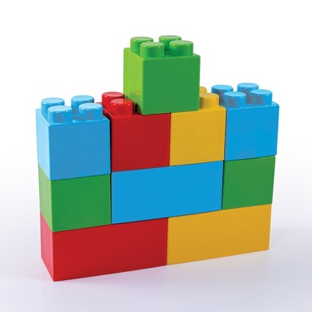


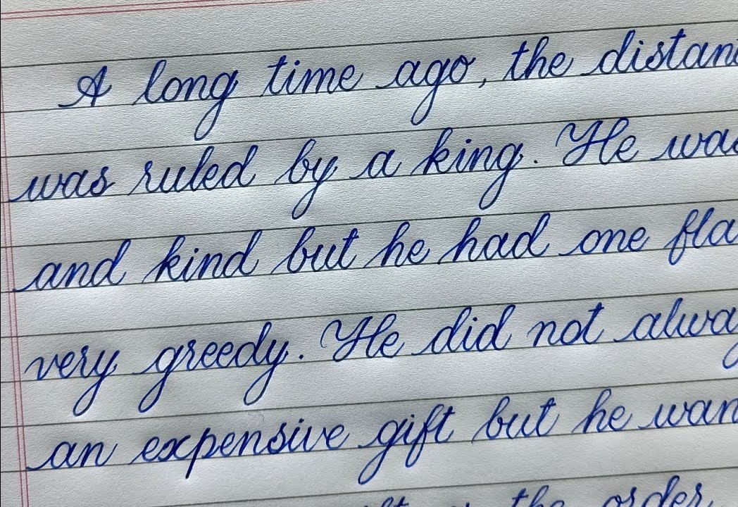
Larger Picture
Addresses specific needs
Thomas Hegghammer
Applied to English too
Increases number of datasets and related tools
Guides future research
Notes:
For a general content analysis, an accuracy of 99.9% is workable, but for large amounts of documents and an application which requires truthful representation of the text, every character matters.
If we treat these document features as extremes, the techniques can still be applied in current cases (handwriting OCR)

Slide 23
Questions?

Slide 24
Sources

